Slide 1

Analysis of Bank Loan Purposes.
By Yen Huynh

Slide 2
Dataset Information
- Dataset “Purchase_Loan.csv” from the Credit Card Fraud Detection Dataset in Kaggle website.
- Information of customers who apply for a loan through the bank.

Slide 3
Ideas
- Do banks make more money when people get a loan depending on loan purposes?
- Should the bank focus on making loan advertisements with medical reasons instead of daily expenses?
- Ex: “We support a loan for your medical treatments with reasonable interest rate” to attract customers who are dealing with their medical pill.

Slide 4
Strategy
- Testing the amounts of credits that the bank loan people depends on the purposes.
- Testing how long it takes to get this loan purpose approve.
Which loan purpose makes more money and saves more time than the other.

Slide 5
Introduce Hypotheses
- Test 1: If there is a difference in average amount of credits in US dollars that customers who apply for a loan with “everyday expenses” purpose and “medicine” purpose.
- Test 2 : If there is a difference in average of how many days it takes for the bank to decide approving or cancelling for customers who apply for a loan with “everyday expenses” purpose and “medicine” purpose.

Slide 6
Analytics Process
- Using Python with Pandas, Seaborn, SciPy libraries.
- Create 2 DataFrames with “everyday expenses” purpose and “medicine” purpose.
- Perform 2 sample t-test on both categories with amounts of credits and days make decisions.
- Get the c.i lower and c.i higher.
- Come to conclusion.

Slide 7
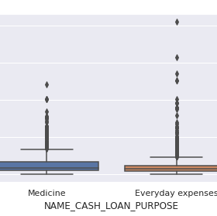
Hypothesis 1:
- Perform 2 sample t-test on amounts of credits between “everyday expenses” loan and “medicine” loan.
- There is a statistically significant difference in average amount of credit between people who have loan of everyday expenses and medicine loan.
- The average amount of credits of ”medicine” loan is at $26,6734 which is higher than ”everyday expenses” loan is at $21,9167.

Slide 8
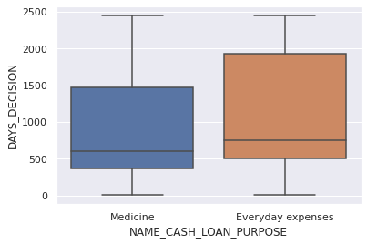
Hypothesis 2:
- Perform 2 sample t-test on days to decide between “everyday expenses” loan and “medicine” loan.
- There is a statistically significant difference in average days to decide between people who have loan of ”everyday expenses” and ”medicine” loan.
- The average of days it takes to decide for ”medicine” loan is at 862 days which is shorter than ”everyday expenses” loan is at 1138 days.

Slide 9
Business Values
- The bank makes more money from people who get a loan for medicine purpose than everyday expenses purpose.
- The bank saves time on deciding to approve a loan for ”medicine” purpose than ”everyday expenses” purpose.
- Businesses can target on making advertisement and promotion to get more people get a loan for medical treatment because it helps to make more money and save times.

Slide 10

Solution/Recommendation
- We make more money and save more time when people get a loan with medicine reason.
- We should focus on getting more people to apply for loan with this purpose by promoting or advertising it.

